Slide 1
Authentication
CSCI 345: Computer and Network Security
Ch. 2
Dr. X

Slide 2
Administrative Stuff
Questions on HW0, HW1
NCL Spring Season dates: https://www.nationalcyberleague.org/spring-season-2020
Security Podcasts worth listening to
Security now: https://www.grc.com/securitynow.htm
Cyberwire: https://thecyberwire.com/
Hacking humans
Blogs:
https://labsblog.f-secure.com/
https://danielmiessler.com/
https://blog.cryptographyengineering.com/
https://www.schneier.com/
https://www.social-engineer.org/blog/
Cybersecurity club meetings on Wednesdays! cofcsecurity.slack.com
Notes:
Set the timer

Slide 3
What does a security professional do?
https://www.cyberdegrees.org/
Notes:
Analyzes situations by finding threats and vulnerabilities to the confidentiality, integrity, and/or availability of a computing system.

Slide 4
Outline
Identification vs Authentication
Passwords
Password Attacks
Password Protection
Biometrics

Slide 5
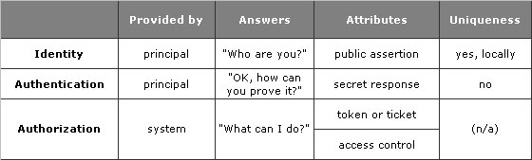
Identification vs Authentication
What is the difference?
Why is it important?
Which one should be private? Which should be public? Why?
https://technet.microsoft.com/en-us/library/cc512578.aspx
Notes:
Identification: who you are
Authentication: proving your identity, a way to restrict access to those only in the “yes” list.
Authentication mechanisms: knows, is, has
Sarah Palin’s email hack: authentication based on something you know and why this is horrible in the age of social networks
Authentication, access control, & crypto: years from now, when we will all be using tech that has not been imagined yet, these three concepts will still be as relevant as they are today.

Slide 6
Outline
Identification vs Authentication
Passwords
Password Attacks
Password Protection
Biometrics

Slide 7

Passwords
Speak “friend” and enter
Problems?
Use
Disclosure
Revocation
Loss
Notes:
Usability: a password for each access is inconvenient
Disclosure: if you share it, it is not secret anymore
Revocation: lock someone out of their account… don’t even think about doing this to your professor
Loss: should we be able to recover password? How are these recovered nowadays?

Slide 8
Outline
Identification vs Authentication
Passwords
Password Attacks
Password Protection
Biometrics

Slide 9
Password vulnerabilities
No password
Same as UID
From common word list
Contained in a short college dictionary
Contained in complete English word list
Contained in common non-English-language dictionaries
Contained in short college dictionary with capitalizations, substitutions etc.
Contained in complete English dictionary with capitalizations, substitutions etc.
Contained in common non-English-language dictionaries with capitalizations, substitutions etc.
Obtained by brute force using alphanumeric characters
Obtained by brute force using all characters

Slide 10

Common passwords
https://www.teamsid.com/100-worst-passwords-top-50/
Lorrie Faith Cranor, CMU
Notes:
SplashID, has just released their eighth annual list of the Worst Passwords of the Year
Appearing for the first time on the list in 23rd place is "donald," which we haven't had before, and we can imagine the source for that password. Somewhat sadly, our longtime podcast favorite "monkey" has slipped five places, down to 18th most popular; while "princess" is debuting for the first time in the 11th slot. So what have we? The top two, surprisingly, have not budged. The password 123456, ranked top last year, still in first place this year.

Slide 11
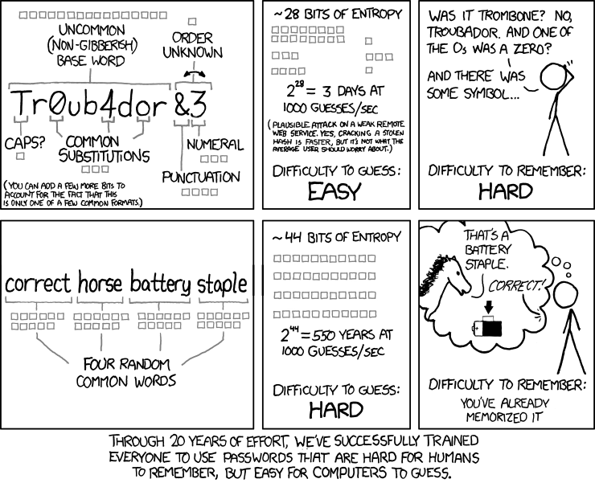
Password strength
https://xkcd.com/936/
Notes:
Information theory people! Let’s analyze this comic in terms of information theory

Slide 12
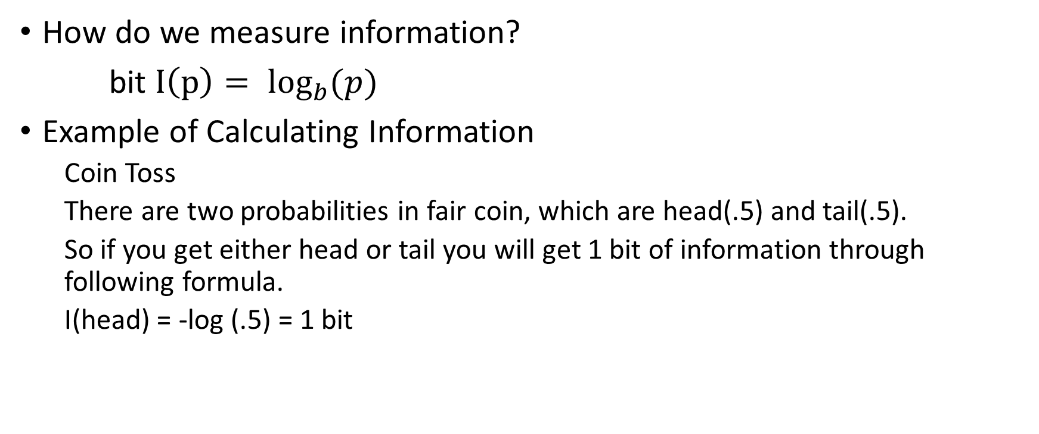
A little bit of information theory
How do we measure information?
bit ${I\left(p\right)= log⁡}_{b}(p)$
Example of Calculating Information
Coin Toss
There are two probabilities in fair coin, which are head(.5) and tail(.5).
So if you get either head or tail you will get 1 bit of information through following formula.
I(head) = -log (.5) = 1 bit
Notes:
p = probability of the event happening
b = base
(base 2 is mostly used in information theory)
*unit of information is determined by base
base 2 = bits base 3 = trits
base 10 = Hartleys base e = nats

Slide 13
What if the coin had heads on both sides?
How much information does the person need to give you for you to know whether the coin ended up heads or tails?
Great Khan Academy class on Information Theory: https://www.khanacademy.org/computing/computer-science/informationtheory/moderninfotheory/v/information-entropy
Notes:
That will depend on whether you know beforehand that a trick coin was used. If you did then you will know it ends up heads always and you don't need any information to know the result. But if you don't know that a trick coin is used then you still need the same amount of information.

Slide 14
What if you had a fair 6 sided die?
For a fair six-sided die, you need log(1/6) bits (base 2 logarithm), that is about 2.6 bits.
Fractional bits are no more a problem here than having something weigh 2.6 kilos.
If it's a loaded die with a greater chance ending up 6, then this will change.

Slide 15
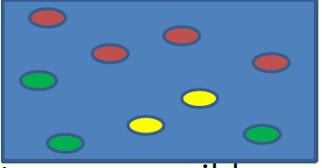
Another example
Balls in the bin
The information you will get by choosing a ball from the bin are calculated as following.
I(red ball) = -log(4/9) = 1.1699 bits
I(yellow ball) = -log(2/9) = 2.1699 bits
I(green ball) = -log(3/9) = 1.58496 bits

Slide 16
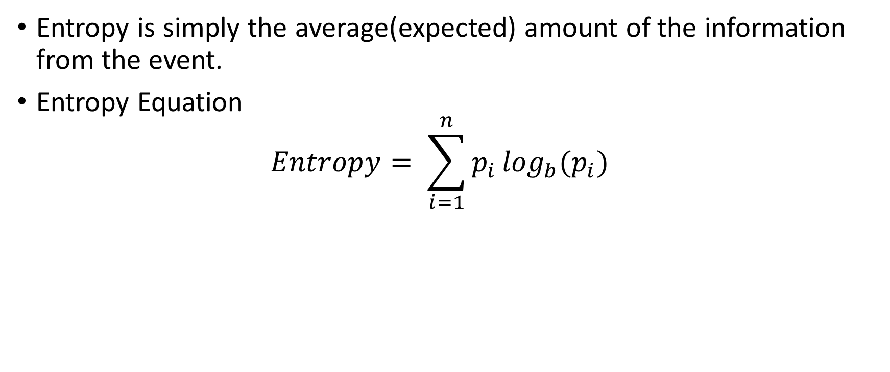
Entropy
Entropy is simply the average(expected) amount of the information from the event.
Entropy Equation $Entropy= \sum_{i=1}^{n}{p_{i }\log_{b}(p_{i})}$
Notes:
n = number of different outcomes
How is it derived?
I = \sum N * p_i log(p_i)
I = total information from N occurrences
N = number of occurrences
(N*Pi) = Approximated number that the certain result will come out in N occurrence
So when you look at the difference between the total Information from N occurrences and the Entropy equation, only thing that changed in the place of N. The N is moved to the right, which means that I/N is Entropy.
Therefore, Entropy is the average(expected) amount of information in a certain event.

Slide 17
So what does all this have to do with the comic???
How many bits of information the passwords contain depend entirely on what you expect of the passwords.
The first panel explains the assumptions for the common password format.
Do hackers know these assumptions?
Does information increase or decrease based on the comic assumptions?
Does entropy increase or decrease with known assumptions?
How can you measure the strength of a password using Entropy?
https://www.logcalculator.net/log-2
Notes:
So what does all this have to do with the comic?
A somewhat uncommon word (16 bits, or a 65-thousand-word vocabulary), one bit for capitalization (of the first letter only), some common substitutions (would depend on the word but estimated to be 3 bits in the comic, seems reasonable), a punctuation character (four bits) and a number (3 bits) always at the end, but they can change order (one more bit). This gives the 28 bits for that format. If you know that the password you're trying to crack follows this format, then the calculations make sense. There's also that side note that you can add a few more bits to cover other common formats.
The other way to make a password, four common words, then gives 11 bits for each word, so a vocabulary of about 2000 words. And since there's four of them you get a total of 44 bits, much more than the other way to make your password. Again, if you know the password is this format, then I don't see anything wrong with the calculations. Note that this means that the attacker already knows that the password consists of four common words and would use a dictionary to crack it. The 44 bits are calculated with this in mind. If the cracker were to assume that all possible letter combinations, mostly non-sense words that is, are possible and equally likely, then the information content would be even higher.
How sensible is it then for a cracker to assume some specific format for the password? I would say that it is very sensible, at least to start the cracking with the common formats. If you get a hold of a whole database of passwords and start brute forcing them, then you might not care if you don't crack all of them, your goal is maybe to just crack some of them. It's pretty safe to assume that the majority of the passwords will follow the few most common password formats so why not try those first. And after that you may just give up on the rest of them or move on to more exotic password formats if you really want to.

Slide 18
Outline
Identification vs Authentication
Passwords
Password Attacks
Password Protection
Biometrics

Slide 19
How NOT to store a password?
Plaintext
Encrypt
Just hash

Slide 20
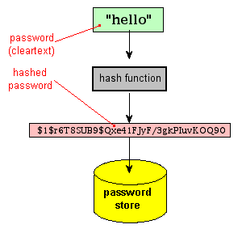
Hashing
http://www.unixwiz.net/techtips/iguide-crypto-hashes.html
https://www.tools4noobs.com/online_tools/hash/
Notes:
Certain number of characters
HAS TO BE IRREVERSIBLE!
A "hash" (also called a "digest", and informally a "checksum") is a kind of "signature" for a stream of data that represents the contents. The closest real-life analog we can think is "a tamper-evident seal on a software package": if you open the box (change the file), it's detected.
We will learn more about different hashing algorithms in the protection part of passwords!

Slide 21
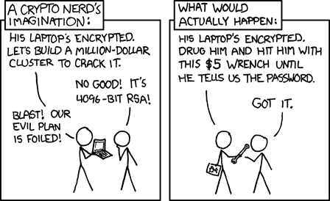
Password Attacks
Guess
Dictionary
Rainbow tables
Notes:
Dictionary: a set of words, hash these, compare with what you have
Rainbow tables: have the hashed table, saves time
Information leaking: inferring info about user

Slide 22
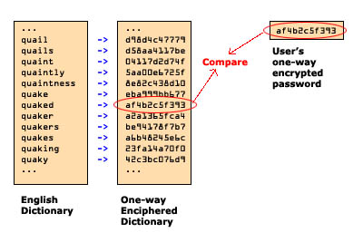
Dictionary attacks
John the Ripper
Hashcat
Hydra
Notes:
Rockyou
Crackstation
This is kinda slow, hackers can do better

Slide 23
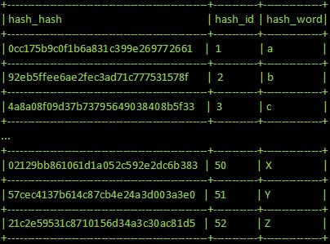
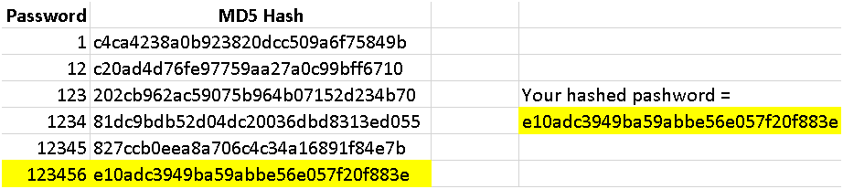
Rainbow tables
https://learncryptography.com/hash-functions/rainbow-tables
Notes:
Rainbow table: precomputed

Slide 24
Outline
Identification vs Authentication
Passwords
Password Attacks
Password Protection
Biometrics

Slide 25
Password protection
Make a better password… please
Good practice: do not use the same password
Store the password properly: hash + salt + pepper
Use a strong hashing algorithm (NOT MD5, NOT SHA1… please)

Slide 26
Better passwords
Increase the entropy
If you have a 42 bit password, what should be the proper way to choose these bits? HINT: think about a coin toss
NIST guidelines
Use characters other than just a-z
Choose a long password
Avoid actual names or words
Use a string you can remember (use an algorithm, password manager)
Use variants for multiple passwords (WRONG, has been revised)
Change password regularly (WRONG, has been revised)
Do not write it down
Do not tell anyone!
Think: Q1 How do the NIST criteria increase the entropy?
Notes:
Demo with my password on dashlane

Slide 27
Salt and Pepper
Salt: extra piece of information added to a password, stored in a separate file than your /etc/shadow/password
Date
Username
Random
Pepper: not stored secret, may defined by application
THINK: Q2 Why does salt and pepper add entropy to a password?
Do they help eliminate
Dictionary attacks?
Rainbow table attacks?
Notes:
A password hash function (PHF) takes two inputs: the password, and a salt. The salt is randomly generated when the user picks his password, and it is stored together with the hashed password PHF(password, salt). (What matters is that two different accounts always have different salts, and randomly generating a sufficiently large salt is a good way to have this property with overwhelming probability.) When the user logs in again, the verification system reads the salt from the password database, computes PHF(password, salt), and verifies that the result is what is stored in the database.
Salts prevent for all passwords to be cracked with a single rainbow table. They do not per se prevent password cracking.
Peppers may be stored in code. They add some security

Slide 28
Hash Functions
Hash function h: deterministic one-way function that takes as input an arbitrary message M (sometimes called a preimage) and returns as output h(M), a small fixed length hash (sometimes called a digest)
Hash functions should have the following two properties:
compression: reduces arbitrary length string to fixed length hash
ease of computation: given message M, h(M) is easy to compute
Notes:
openssl speed sha
Used for both digital signatures and password saving
Message digest
Can also be used for non-repudiation, authenticity, correctness

Slide 29
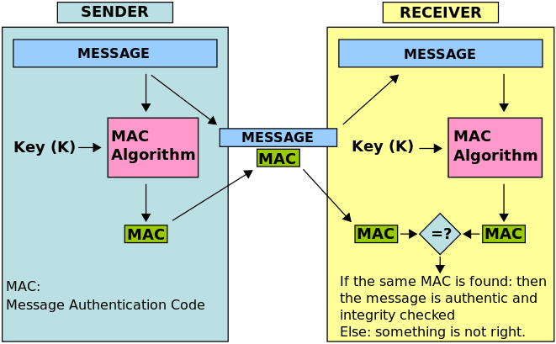
Why are hashes useful?
Message authentication codes (MACs):
e.g.: MAC(M) = h(K|M) (but don't do this, use HMAC instead)
Modification detection codes:
detect modification of data
any change in data will cause change in hash
Notes:
In cryptography, a message authentication code (MAC), sometimes known as a tag, is a short piece of information used to authenticate a message—in other words, to confirm that the message came from the stated sender (its authenticity) and has not been changed. The MAC value protects both a message's data integrity as well as its authenticity, by allowing verifiers (who also possess the secret key) to detect any changes to the message content.
In cryptography, a keyed-hash message authentication code (HMAC) is a specific type of message authentication code (MAC) involving a cryptographic hash function and a secret cryptographic key. It may be used to simultaneously verify both the data integrity and the authentication of a message, as with any MAC.

Slide 30
Hash functions
Prof. Pedantic proposes the following hash function, arguing that it offers both compression and ease of computation.
h(M) = 0 if the number of 0s in M is divisible by 3
h(M) = 1 otherwise
Q3: Why is this a lousy crypto hash function?

Slide 31
Cryptographic Hash Functions
Properties of good cryptographic hash functions:
preimage resistance: given digest y, computationally infeasible to find preimage x' such that h(x')=y (also called “one-way property”)
2nd-preimage resistance: given preimage x, computationally infeasible to find preimage x' such that h(x)=h(x') (also called “weak collision resistance”)
collision resistance: computationally infeasible to find preimages i,j such that h(i)=h(j) (also called “strong collision resistance”)
Notes:
Preimage protects bitcoin

Slide 32
In other words
A good cryptographic hash function has the following properties:
it is deterministic so the same message always results in the same hash
it is quick to compute the hash value for any given message
it is infeasible to generate a message from its hash value except by trying all possible messages
a small change to a message should change the hash value so extensively that the new hash value appears uncorrelated with the old hash value
it is infeasible to find two different messages with the same hash value (from https://en.wikipedia.org/wiki/Cryptographic_hash_function)
Notes:
Avalanche effect

Slide 33
Birthday Attack
Birthday Paradox: chances that 2+ people share birthday in group of 23 is > 50%.
General formulation
function f() whose output is uniformly distributed over H possible outputs
Number of experiments Q(H) until we find a collision is approximately
https://betterexplained.com/articles/understanding-the-birthday-paradox/

Slide 34
Practical Implications
Why is this relevant to hash sizes?
Choosing two messages that have the same hash h(x) = h(x’) is more practical than you might think.

Slide 35
Some cryptographic hash functions
MD5 (128-bit digest) [don’t use this]
SHA-1 (160-bit digest) [stop using this*]
SHA-256 (256-bit digest)
SHA-512 (512-bit digest)
SHA-3 [recent competition winner]
Notes:
SHA 1 attack: create two plaintexts that produce the same hash digest in 2^63 steps, far shorter than the 2^80 steps expected of a 160-bit hash function. Not useless but better to use longer keys

Slide 36
General Structure of a Hash

Slide 37
Comparison of SHA parameters

Slide 38
SHA-512

Slide 39
SHA-512 function

Slide 40
SHA-512

Slide 41
Outline
Identification vs Authentication
Passwords
Password Attacks
Password Protection
Biometrics

Slide 42
Biometrics for authentication
Fingerprint
Hand geometry
Retina and iris
Voice
Handwriting
Typing characteristics
Blood vessels in the finger of the hand
Face
Facial features

Slide 43
Problems with biometrics
Intrusive
Costly
Single point of failure
Threshold for acceptance
False reading
Notes:
False negative consequences are far less than false positive

Slide 44
Confusion Matrix
Notes:
Works for any dichotomous system or test

Slide 45
Sensitivity vs specificity vs accuracy
Sensitivity: degree to which the sensor selects the names that correctly match the person
Specificity: proportion of negative results among people who are not sought
Accuracy: degree to which the test correctly flags the condition or situation
Prevalence: how common a condition or situation is
Let’s derive the formulas based on the confusion matrix
Notes:
Sensitivity: true positive
Specificity: True negative

Slide 46
Summary
Password attacks are fairly easy if one has the hashes
How easy is it to get the hash?
Hashing, salts, & peppers are ways to securely store passwords
Not all hashes are as strong
Hashing is a mathematical function that diffuses and transposes the password information
NIST: good password guidelines
Biometrics may be the future… for better or worse
Notes:
NIST offers many other guidelines

Slide 47
Sources
Hashing Tutorial https://www.tutorialspoint.com/cryptography/cryptography_hash_functions.htm
Computerphile videos – good intro
https://www.youtube.com/watch?v=b4b8ktEV4Bg
https://www.youtube.com/watch?v=8ZtInClXe1Q
Great explanation on one way hash functions https://security.stackexchange.com/questions/11717/why-are-hash-functions-one-way-if-i-know-the-algorithm-why-cant-i-calculate-t/19658#19658
Crackstation on salts: https://crackstation.net/hashing-security.htm#salt

